Slide 1
io.Tians
P R E S E N T S

Slide 2
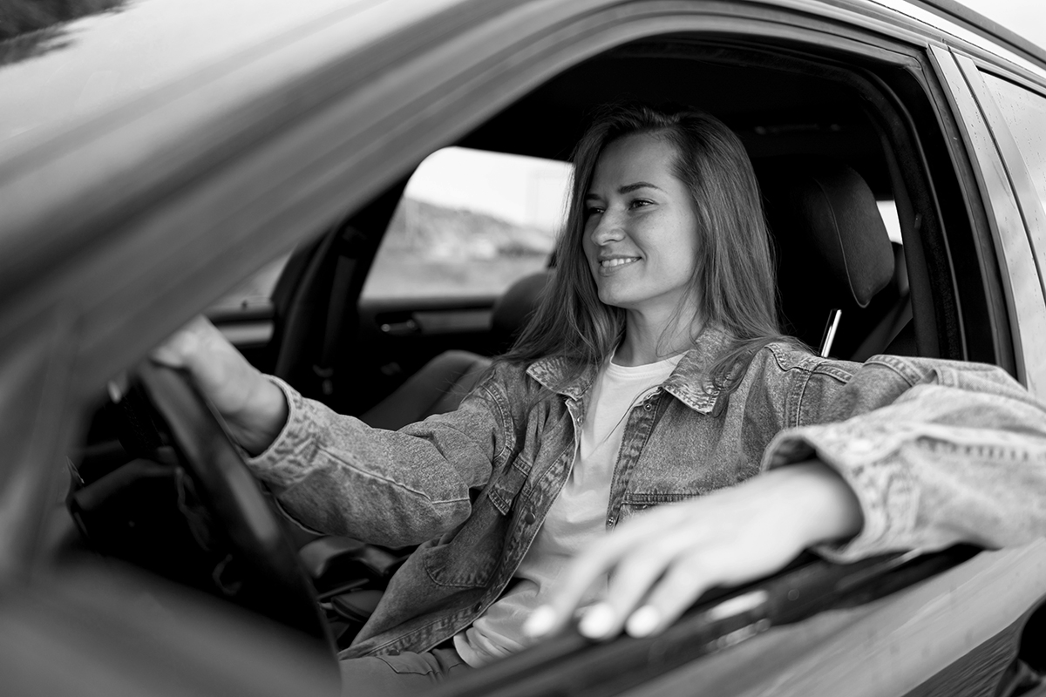
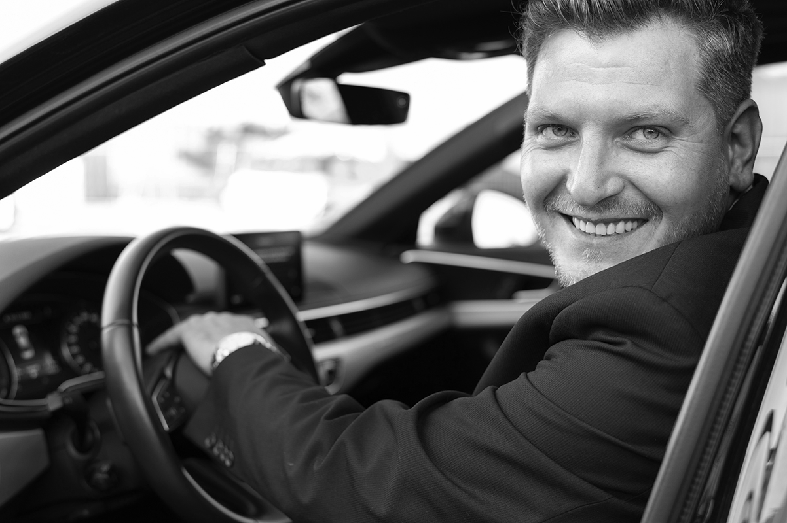
Our team
Patel Mann (Team Leader)
Akshit Shekhda
Ronak Patel
Harsh Mistry
Mentor: Prof. Vimal Bhatt
VSITR-KSV

Slide 3
Social Welfare:
Organized public or private social services for the assistance of disadvantaged" groups.
Some examples are Medicaid, disability, Income. low-income housing and SNAP program.
As accidents cases are increasing, we have heard about many cases, where deaths occurred due to communication gap (when accident occurred).
Social welfare signifies the attempts made by governments and voluntary organizations to help families and individuals by providing medical care and public health services, by providing services to facilitate social adjustment.

Slide 4
Table of contents
01
The project
04
Solution
02
Problem
Blockdiagram
05
03
Project goals
06
Conclusion
IOT in Vehicles
IOT Device solves lack of communication during road Accidents.
Increasing Death Rate due to lack of communication during Accident.
Air bag system
Implementation Diagram
To reduce death rates during accidents due to lack of communication.
Victim gets help due to communication and gets aid as early as possible.

Slide 5
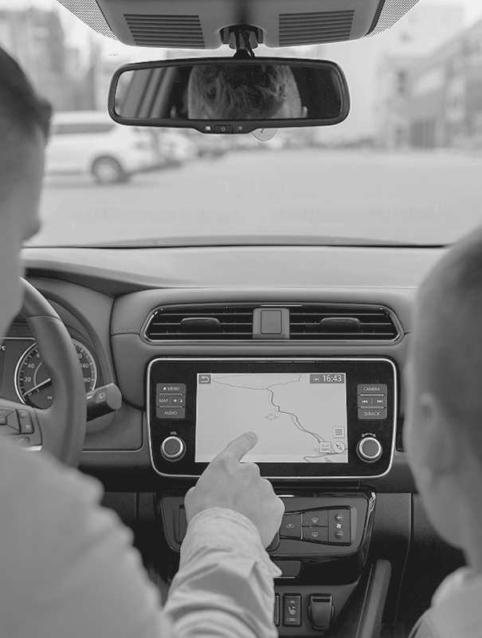
01
The
Project
IOT IN VEHICLES

Slide 6
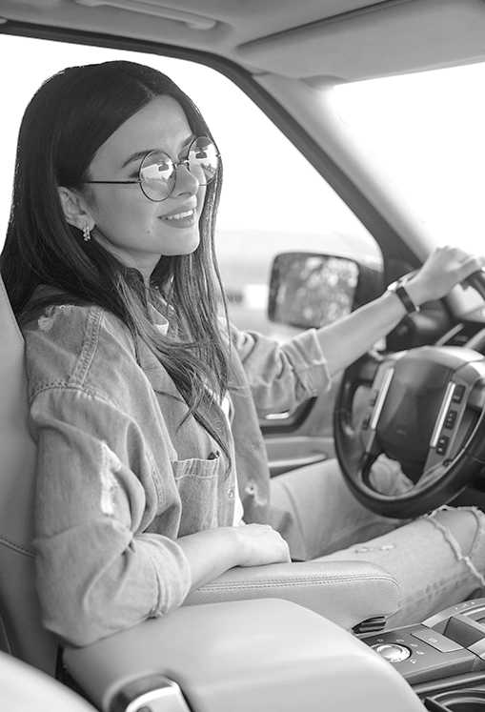
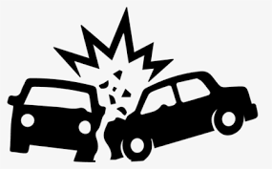
Aim:
To Reduce the Death Rate which occurs due to lack of communication or delay in communication in car Accidents.
These are semi-autonomous cars infused with IoT that, in addition to making decisions, control a portion of the vehicle's operations to prevent accidents

Slide 7
02
Problem Statement

Slide 8
Problem:
About 450,000 accidents take place in India annually, of which 150,000 people die.
When a road accident occurs, the police communications officer, generally receives the first call.
If the caller reports injuries, the emergency medical services dispatcher is notified immediately; but if the caller is uncertain of injuries, the operator may wait.
Most often an ambulance is not needed.
However, in nearly 27% of fatal road accidents in India, waiting for confirmation of need resulted in a delay of 5 minutes or more in the dispatch of an ambulance.
These are semi-autonomous cars infused with IoT that, in addition to making decisions, control a portion of the vehicle's operations to prevent accidents

Slide 9
03
Project Goal

Slide 10
Main Aim of Project
Life Saving
Reduce Death Rate
Life is very Precious thing, nothing can be achieved without life. Hence our main Motto is to save a Life.
About 450,000 accidents take place in India annually, of which 150,000 people die. we wish to decrease death rate especially due to lack of communication .

Slide 11
04
Solution & Working

Slide 12
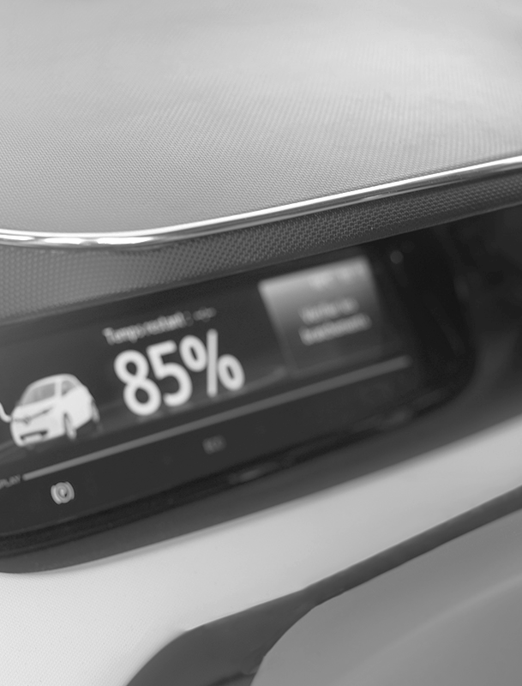
Solution:
To solve this problem we have made a device, which activates when the Air Bags opens during accidents.
Working:
When the Air Bags opens during accident our device get activates, send message and location to some close ones and emergency services. So the victim, can get needed medical aids and services as soon as possible.

Slide 13
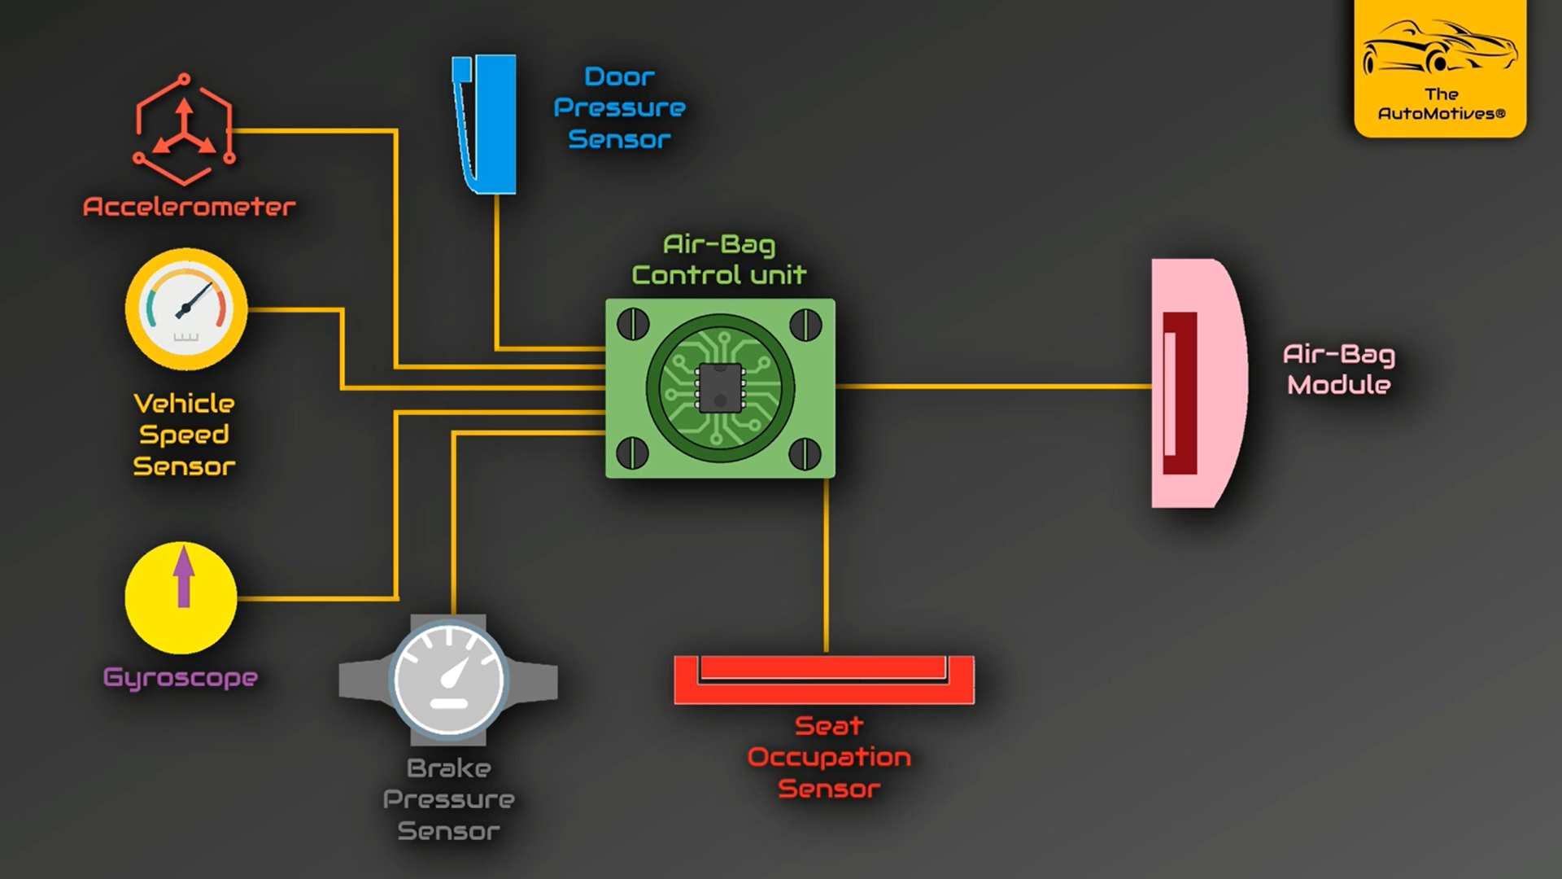
Air Bag System !

Slide 14

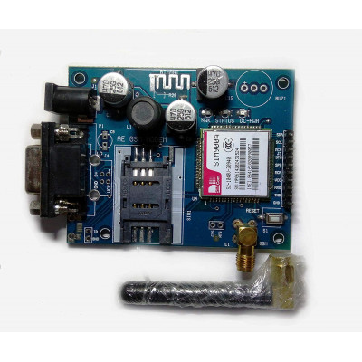
Major requirements
Arduino Uno:
Arduino is an open-source electronics platform based on easy-to-use hardware and software.
GSM Sim 900A:
A GSM modem is a wireless modem that works with a GSM wireless network. A wireless modem behaves like a dial-up modem.

Slide 15
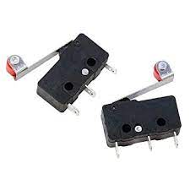
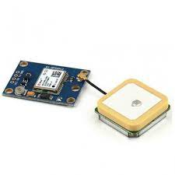
Major requirements
Limit Switch:
In electrical engineering, a limit switch is a switch operated by the motion of a machine part or the presence of an object.
Ublox neo-6m gps module:
The chip measures less than the size of a postage stamp but packs a surprising amount of features into its little frame.

Slide 16
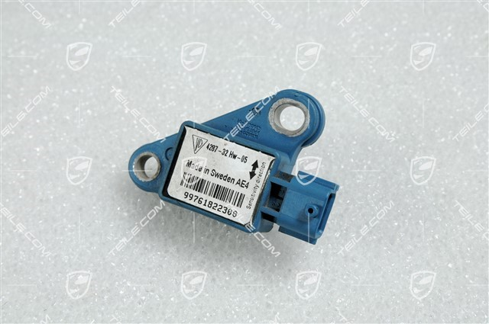
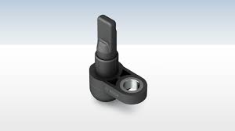
Sensors Used in Airbag System
Acceleration Sensors:
Linear acceleration sensors, also called G-force sensors, are devices that measure acceleration caused by movement, vibration, collision, etc.
Wheel Speed Sensors:
Wheel Speed Sensors measure the road-wheel speed and direction of rotation. These sensors provide input to a number of different automotive systems including the antilock brake system and electronic stability control.

Slide 17
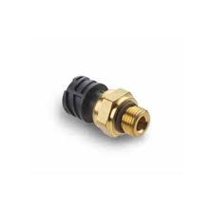
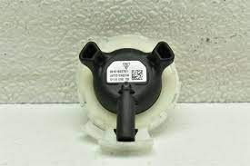
Sensors Used in Airbag System
Brake Pressure Sensors:
Automobiles with an internal combustion engine use a fluid pressure sensor to monitor the engine oil pressure. In most modern vehicles, this is a pressure switch; however older vehicles and some high-end modern vehicles monitor and display the actual oil pressure. Fluid pressure switches simply monitor the presence or absence of the fluid in the vicinity of the sensor.
Door Pressure Sensor:
An analysis of a sample of lateral collisions has demonstrated that the optimum position for a side impact airbag sensor is in the lower rear quadrant of the front door.

Slide 18
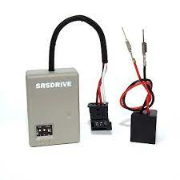
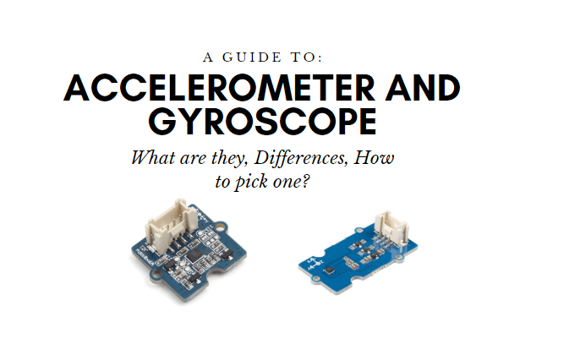
Sensors Used in Airbag System
Seat Occupancy Sensor:
A vehicle's passenger occupancy sensor detects whether a passenger is in the seat and decides whether or not to allow the airbag to deploy in the event of an accident. If the sensor determines a weight on the seat is not a person, the airbag does not deploy.
Gyroscope sensor:
Gyroscope sensor is a device that can measure and maintain the orientation and angular velocity of an object. These are more advanced than accelerometers. These can measure the tilt and lateral orientation of the object whereas accelerometer can only measure the linear motion.

Slide 19
05
Blockdiagram

Slide 20
Implementation Diagram !
Message and Location sent successfully
Our Device

Slide 21
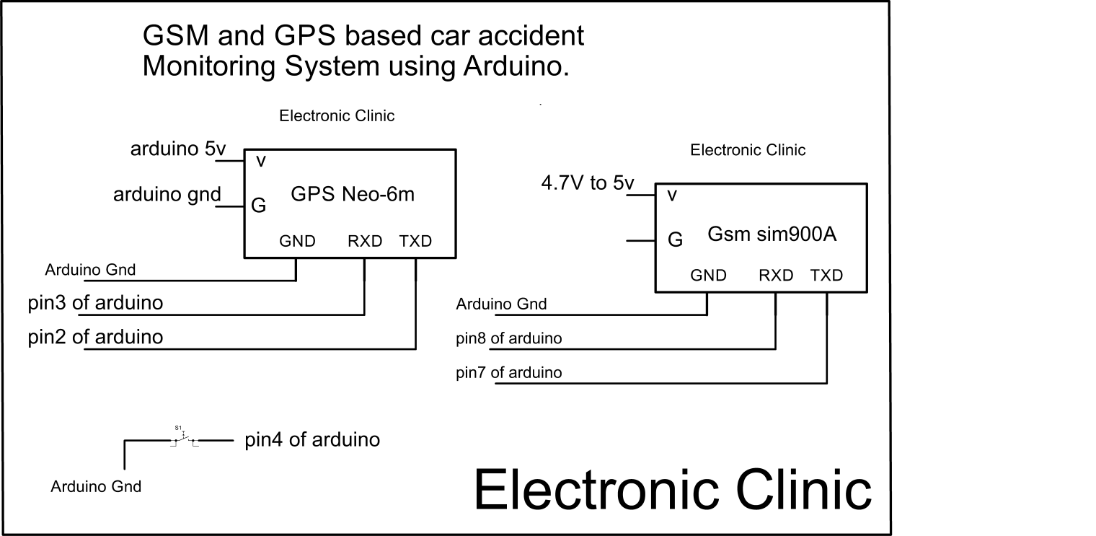
Circuit Diagram

Slide 22
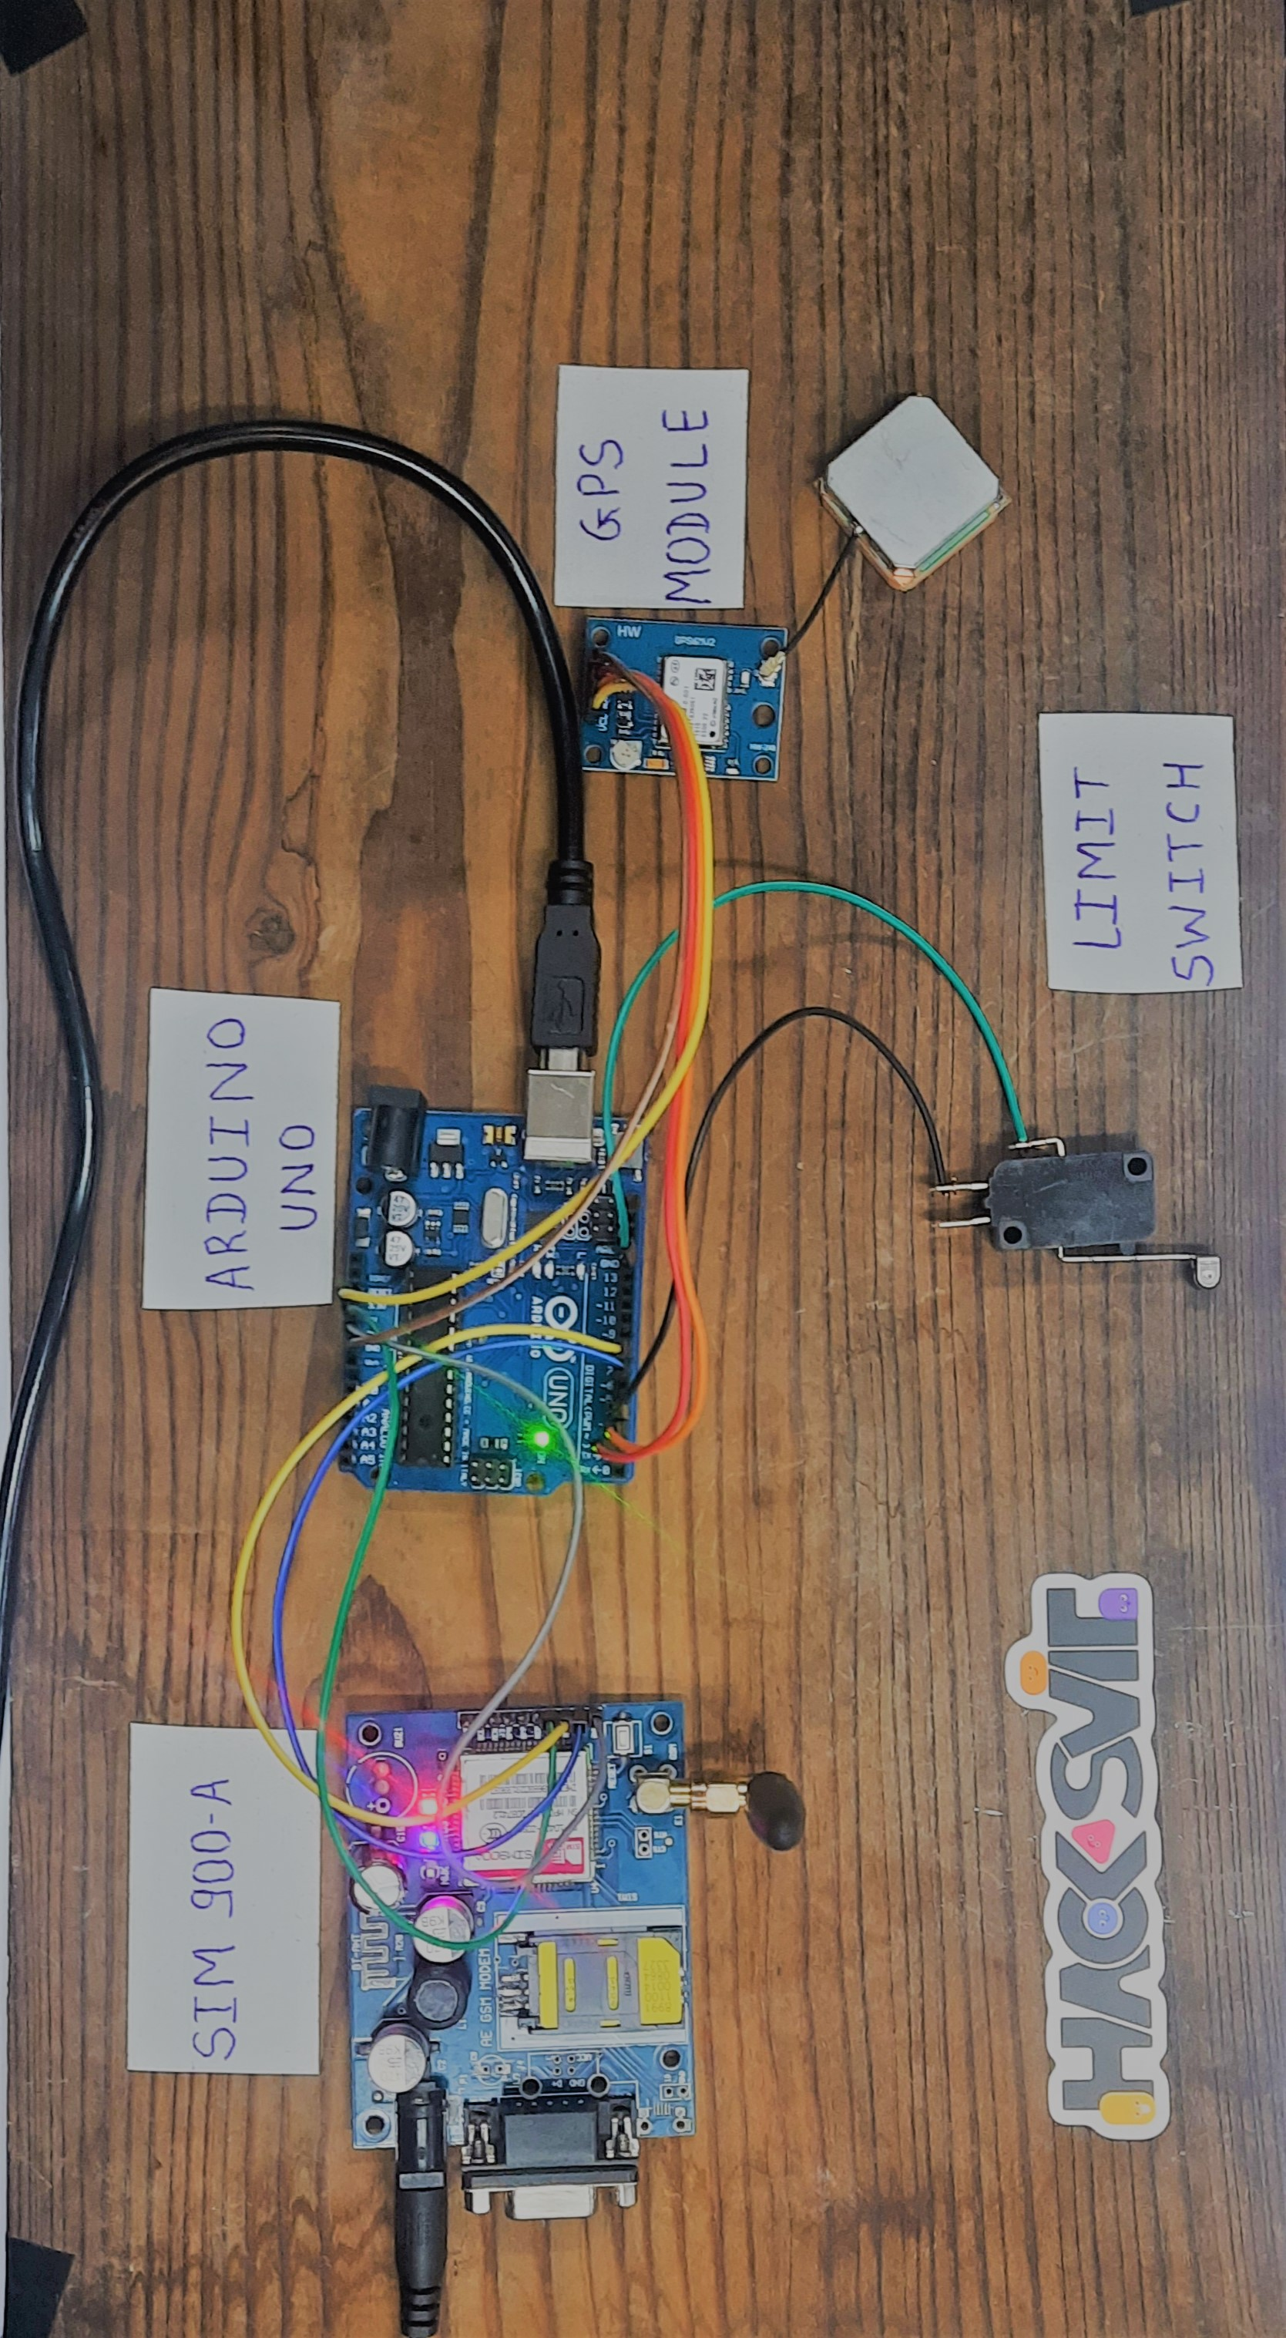
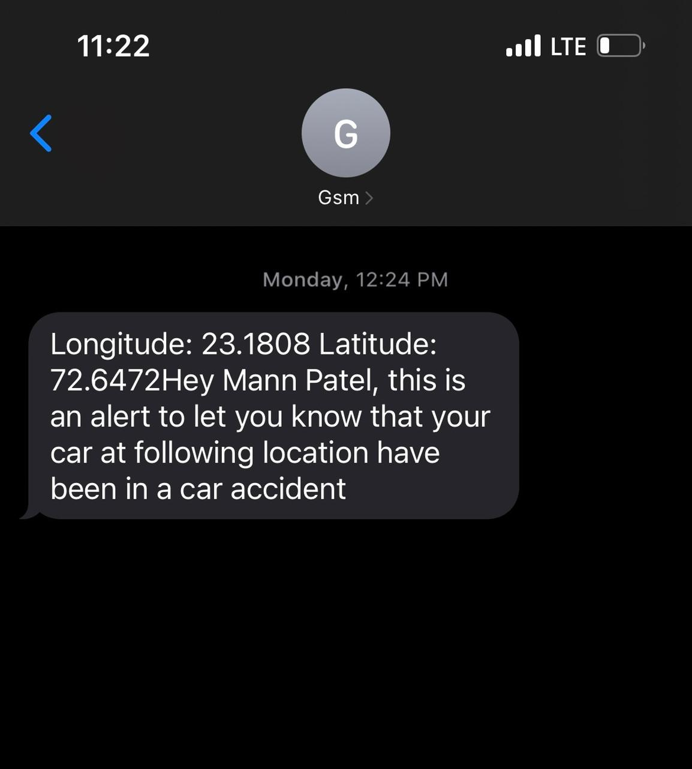
Concept
Circuit
Output

Slide 23
Further Implementation

Slide 24
Further Implementation
1.MQ3 Sensor
2.Web App
The Grove - Gas Sensor(MQ3) module is useful for gas leakage detection (in home and industry). It is suitable for detecting Alcohol, Benzine, CH4, Hexane, LPG, CO. Due to its high sensitivity and fast response time, measurements can be taken as soon as possible.
We will attach MQ3 Sensor with our device, so whenever the driver enters the car MQ3 sensor will detect if the driver is drunk or not and if the driver is drunk the car engine will not gets ON and send alert to close ones.
If the driver, drinks while driving then the led sensor will blink and send alert to close ones.
Furthermore we are designing an web application which will collect close relative ‘s data and accordingly make changes in the Device code and also maintains the record.
Technology used:
Frontend:
HTML, CSS, JAVASCRIPT
Backend:
Pyserial, Conda, Python, Pypi
Database:
MySQL
API:
REST API, TWILIO API

Slide 25
06
Conclusion

Slide 26
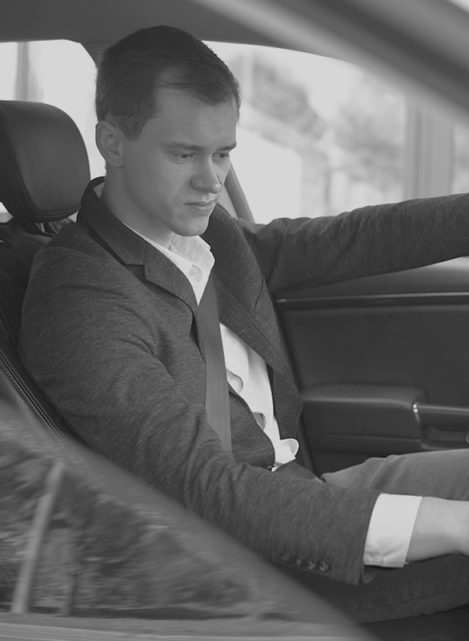
Outcome
In conclusion, we achieve our main goal which was saving precious life by overcoming lack of communication problem during car road accidents.

Slide 27
T H A N K Y O U

